Slide 1
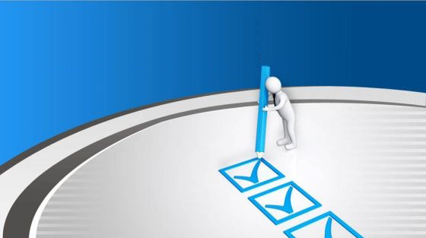
Modern Marketing Check List
Does Google know you’re local?
Does your website look like you're relevant?
Do you market on Facebook?
Is your website phone-friendly?
Do you write short articles or blog?
Are you remarketing?
Do you sell what Gen Y will buy?
Do your young employees promote your business on social media?

Slide 2
IN-DEMAND
INCREASE | PRESENCE
BOOST | AWARENESS
ENHANCE | BRANDING
CREATE | #1 POSITION
MAINTAIN | DOMINANCE

